Slide 1

INTERMDIATE EXCEL STATISTICS FOR BUSINESS ANALYTICS

Slide 2

George Mount
Data Analyst & Educator at Stringfest Analytics
George works as an independent analyst and data analytics educator with the goal to help clients manage their data so they think more creatively. He serves as a technical expert and lead curriculum developer for Thinkful’s data analytics program and is the instructor of the DataCamp course “Survey and Measure Development in R.”
George blogs about data, innovation, and career development at georgejmount.com. He holds a master’s degree in information systems with a certificate of achievement in quantitative methods from Case Western Reserve University

Slide 3

COURSE OBJECTIVES
Test for differences across multiple groups and at multiple points in time
Model a causal relationship between two variables
Make graphical representations of one or more variables
Make compelling business recommendations using inferential statistics
Intermediate Excel Statistics for Business Analytics
Notes:
--- Update!
Objectives for today – while we will get into some of the theory, I really want to frame what we are learning in the context of business application and know-how as possible.
So, you are able to explain in plain English the kinds of business questions that could be answered with a t-test. You can write a sound hypothesis. You can know how to size up a dataset to get a sense of the kinds of story the data can show.

Slide 4

WHY WOULD WE DO THIS IN EXCEL?
“You get to look at the data every step of the way, building confidence while learning the tricks of the trade.”
-- John Foreman
Excel Statistics for Business Analytics
Notes:
With the rise of data science programming in R and Python it seems silly to want to do this in Excel but we can really get hands-on this way. We get a lot more up close and personal analysis of the data.

Slide 5
FOLLOWING ALONG
Each section is a sub-folder
Demos = follow along with me
Drills = try it yourself
Refresh your memory with the demo notes
Intermediate Excel Statistics for Business Analytics
Notes:
This is an Excel class, so we won’t be looking at PowerPoint the whole time – to follow along, you will see that all assets are divided by section.
Some of our Excel time will be Demos – for this I will be walking through some procedure in Excel.
If you need any datasets they will be included in each sub-folder.
Then there may be a Drill where you will work on it for yourself during some specified period of time.
I have provided written notes/instructions about the Demos which you can refer to while working on the Drills.

Slide 6
HAVE YOU INSTALLED THE DATA ANALYSIS TOOLPAK?
Notes:
Has everyone done this? If not, check the demo notes and/or follow along with the next two slides.
The steps are different for Mac versus Excel.

Slide 7
ON WINDOWS: ON MAC:
File
Options
Add-ins
Go
Check on Analysis ToolPak
OK
Tools
Excel Add-ins
Check on Analysis ToolPak
Click OK
Notes:
Give me a thumbs up when everyone has this installed.
Open up the wages dataset, we will now summarize a continuous variable (wage) using the Analysis ToolPak.
Another reminder to use the demo notes.

Slide 8
1. EXPECTED VALUES AND REPEATED MEASURES
Notes:
-- Update!
Let’s begin with Exploratory Data Analysis in Excel.
Pulse check – who has heard of this term before and how would you define it? Or outside of defining it, what are some examples of it?

Slide 9

Warm-up
File: abalone-warmup.xlsx
Is there a significant difference in the diameter of male versus female snails?

Slide 10
Warm-up
Solution: abalone-warmup-solution.xlsx
For a refresher: Excel Statistics for Business Analytics

Slide 11
What’s next?
What about the difference between male, female and infant snails?
Multiple groups… no more t-test! (Sort of)…

Slide 12

EDA, PART DEUX
Notes:
-- Update!
When we get a dataset, we want to see the kinds of variables we have. Think of each variable as like an ingredient. And based on those ingredients we can make different dishes. Like a “Chopped” competition.

Slide 13
There’s ALWAYS room for descriptives!
Central tendency
Expected value = mean
Variability
Distribution

Slide 14
Every picture tells a story
Visualizing distributions with histograms and box plots
Demo: iris-visualization.xlsx

Slide 15
DRILL
File: abalone-visualizations.xlsx
Visualize the distribution of shucked_wgt by sex
(Don’t forget about the demo notes)
Notes:
Let’s take an example here, and don’t forget about the demo notes!

Slide 16
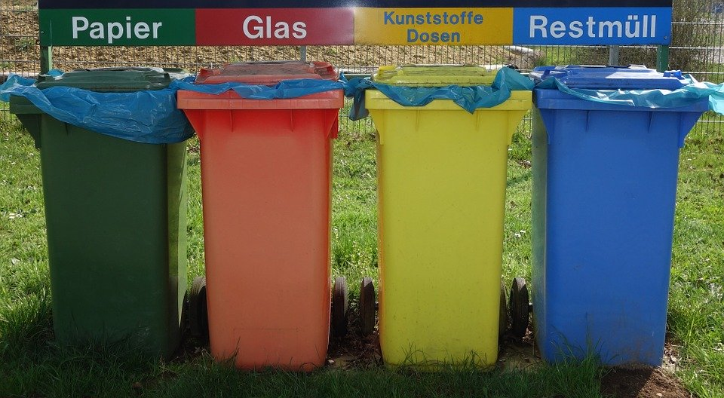
COMPARING THE MEANS OF MORE THAN TWO GROUPS
Notes:
-- Update!
When we get a dataset, we want to see the kinds of variables we have. Think of each variable as like an ingredient. And based on those ingredients we can make different dishes. Like a “Chopped” competition.

Slide 17
ANALYSIS
OF
VARIANCE
Notes:
Basic overview of the types of variables:
Broad split b/w categorical and quantitative
First, categorical. For these, there are a fixed number of values that variable can take:
- In the case of binary, it’s two (yes/no, black/white)
- Nominal can have more than two, think of all 50 states, or 7 days of the week
- For ordinal, order matters, consider Freshman/Sophomore/Junior/Senior. However this corresponds to years 1, 2, 3, 4, so these can be numbers too!
Then, quantitative. These are numeric
- With a difference that with discrete, there are only a certain number of values that can be taken, for example, you can’t have 2.5 children, but we often use that as a statistical convenience, so you will see there is some wiggle room here.
- Finally, continuous – this is the one for which there can be any possible value. Height/weight/blood pressure. A lot of things in the natural world. Also money is for all intents & purposes continuous.

Slide 18
ASSUMPTIONS
Subjects are randomly sampled
Normality of each group
Population variance is equal for all groups
Notes:
-- Update
Basic overview of the types of variables:
Broad split b/w categorical and quantitative
First, categorical. For these, there are a fixed number of values that variable can take:
- In the case of binary, it’s two (yes/no, black/white)
- Nominal can have more than two, think of all 50 states, or 7 days of the week
- For ordinal, order matters, consider Freshman/Sophomore/Junior/Senior. However this corresponds to years 1, 2, 3, 4, so these can be numbers too!
Then, quantitative. These are numeric
- With a difference that with discrete, there are only a certain number of values that can be taken, for example, you can’t have 2.5 children, but we often use that as a statistical convenience, so you will see there is some wiggle room here.
- Finally, continuous – this is the one for which there can be any possible value. Height/weight/blood pressure. A lot of things in the natural world. Also money is for all intents & purposes continuous.

Slide 19
HYPOTHESES
Ho: No difference in population means of all groups
Ha: A difference in population means of all groups
Notes:
-- Update
Basic overview of the types of variables:
Broad split b/w categorical and quantitative
First, categorical. For these, there are a fixed number of values that variable can take:
- In the case of binary, it’s two (yes/no, black/white)
- Nominal can have more than two, think of all 50 states, or 7 days of the week
- For ordinal, order matters, consider Freshman/Sophomore/Junior/Senior. However this corresponds to years 1, 2, 3, 4, so these can be numbers too!
Then, quantitative. These are numeric
- With a difference that with discrete, there are only a certain number of values that can be taken, for example, you can’t have 2.5 children, but we often use that as a statistical convenience, so you will see there is some wiggle room here.
- Finally, continuous – this is the one for which there can be any possible value. Height/weight/blood pressure. A lot of things in the natural world. Also money is for all intents & purposes continuous.

Slide 20

WHY ANOVA? WHY NOT ANOME?
Notes:
-- Update!
When we get a dataset, we want to see the kinds of variables we have. Think of each variable as like an ingredient. And based on those ingredients we can make different dishes. Like a “Chopped” competition.

Slide 21
BETWEEN-GROUP vs WITHIN-GROUP
Notes:
-- Update
Basic overview of the types of variables:
Broad split b/w categorical and quantitative
First, categorical. For these, there are a fixed number of values that variable can take:
- In the case of binary, it’s two (yes/no, black/white)
- Nominal can have more than two, think of all 50 states, or 7 days of the week
- For ordinal, order matters, consider Freshman/Sophomore/Junior/Senior. However this corresponds to years 1, 2, 3, 4, so these can be numbers too!
Then, quantitative. These are numeric
- With a difference that with discrete, there are only a certain number of values that can be taken, for example, you can’t have 2.5 children, but we often use that as a statistical convenience, so you will see there is some wiggle room here.
- Finally, continuous – this is the one for which there can be any possible value. Height/weight/blood pressure. A lot of things in the natural world. Also money is for all intents & purposes continuous.

Slide 22
DEMO
Demo: abalone.xlsx
Is there a difference in shucked weight across all groups?
Notes:
Let’s take an example here, and don’t forget about the demo notes!

Slide 23
DEMO
Demo: abalone.xlsx
Is there a difference in shucked weight across all groups?
What pairs are actually different?
Watch out for that p!
Notes:
Let’s take an example here, and don’t forget about the demo notes!

Slide 24
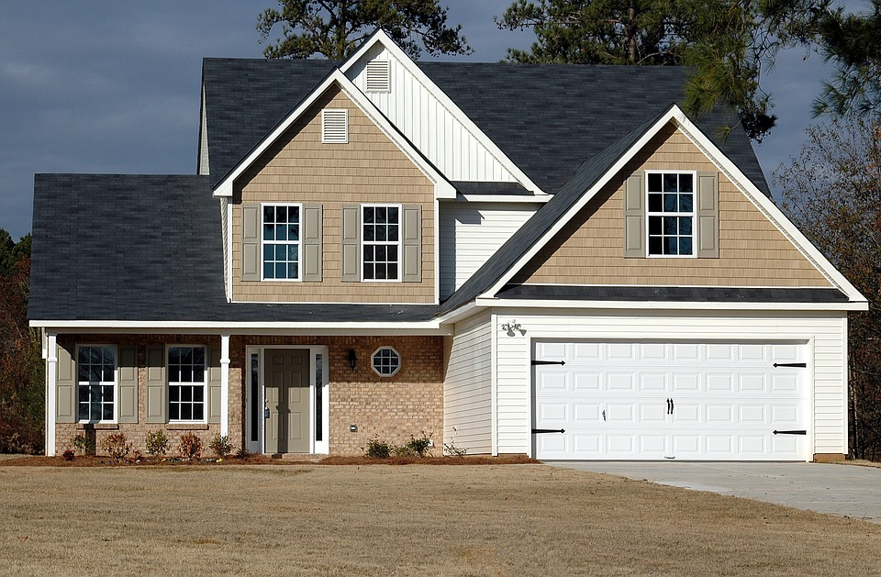

SOLD: $200,000
SOLD: $200,000
If this were true in the population, you’d have found this in < .005% of samples due to random error.
Notes:
Your turn to walk through a t-test.

Slide 25
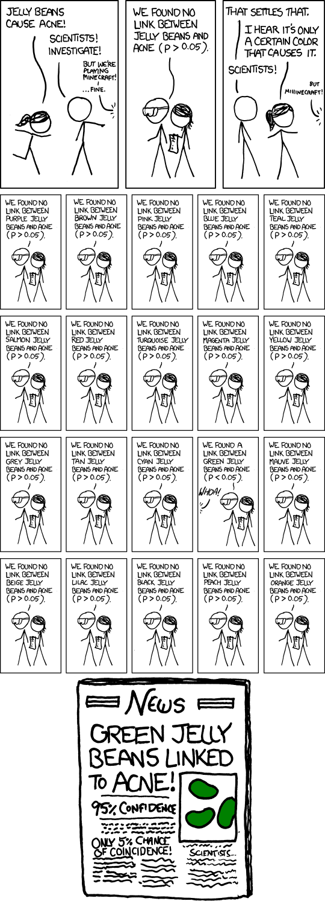
IT HAPPENS
https://xkcd.com/882/
Notes:
-- Update
Basic overview of the types of variables:
Broad split b/w categorical and quantitative
First, categorical. For these, there are a fixed number of values that variable can take:
- In the case of binary, it’s two (yes/no, black/white)
- Nominal can have more than two, think of all 50 states, or 7 days of the week
- For ordinal, order matters, consider Freshman/Sophomore/Junior/Senior. However this corresponds to years 1, 2, 3, 4, so these can be numbers too!
Then, quantitative. These are numeric
- With a difference that with discrete, there are only a certain number of values that can be taken, for example, you can’t have 2.5 children, but we often use that as a statistical convenience, so you will see there is some wiggle room here.
- Finally, continuous – this is the one for which there can be any possible value. Height/weight/blood pressure. A lot of things in the natural world. Also money is for all intents & purposes continuous.

Slide 26
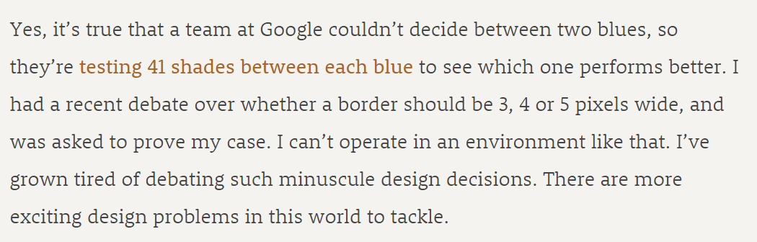
IT HAPPENS
https://stopdesign.com/archive/2009/03/20/goodbye-google.html
Notes:
-- Update
Basic overview of the types of variables:
Broad split b/w categorical and quantitative
First, categorical. For these, there are a fixed number of values that variable can take:
- In the case of binary, it’s two (yes/no, black/white)
- Nominal can have more than two, think of all 50 states, or 7 days of the week
- For ordinal, order matters, consider Freshman/Sophomore/Junior/Senior. However this corresponds to years 1, 2, 3, 4, so these can be numbers too!
Then, quantitative. These are numeric
- With a difference that with discrete, there are only a certain number of values that can be taken, for example, you can’t have 2.5 children, but we often use that as a statistical convenience, so you will see there is some wiggle room here.
- Finally, continuous – this is the one for which there can be any possible value. Height/weight/blood pressure. A lot of things in the natural world. Also money is for all intents & purposes continuous.

Slide 27
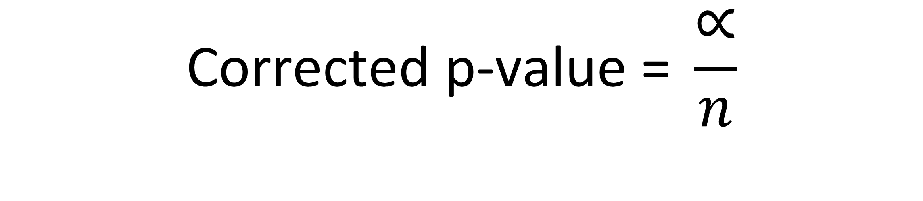
BONFERRONI CORRECTION
1 – confidence level (usually 5%)
$$\text{C}\text{orrected} \text{p}\text{-}\text{value}\text{ = }\frac{∝}{n}$$
Number of groups compared
Notes:
-- Update
Basic overview of the types of variables:
Broad split b/w categorical and quantitative
First, categorical. For these, there are a fixed number of values that variable can take:
- In the case of binary, it’s two (yes/no, black/white)
- Nominal can have more than two, think of all 50 states, or 7 days of the week
- For ordinal, order matters, consider Freshman/Sophomore/Junior/Senior. However this corresponds to years 1, 2, 3, 4, so these can be numbers too!
Then, quantitative. These are numeric
- With a difference that with discrete, there are only a certain number of values that can be taken, for example, you can’t have 2.5 children, but we often use that as a statistical convenience, so you will see there is some wiggle room here.
- Finally, continuous – this is the one for which there can be any possible value. Height/weight/blood pressure. A lot of things in the natural world. Also money is for all intents & purposes continuous.

Slide 28
DEMO
Demo: abalone-anova.xlsx
What groups are different? (Pairwise t-tests)
How do we adjust for experimentwise error?
Notes:
Let’s take an example here, and don’t forget about the demo notes!

Slide 29
DRILL
iris.xlsx
Is there a significant difference across groups?
Notes:
Let’s take an example here, and don’t forget about the demo notes!

Slide 30
The infant becomes the snail
How do we measure differences in time across same individuals?
Repeated measures

Slide 31

PAIRED SAMPLE T-TEST
Notes:
When we get a dataset, we want to see the kinds of variables we have. Think of each variable as like an ingredient. And based on those ingredients we can make different dishes. Like a “Chopped” competition.

Slide 32
ASSUMPTIONS
The data is paired
Normality at each time point
Notes:
-- Update
Basic overview of the types of variables:
Broad split b/w categorical and quantitative
First, categorical. For these, there are a fixed number of values that variable can take:
- In the case of binary, it’s two (yes/no, black/white)
- Nominal can have more than two, think of all 50 states, or 7 days of the week
- For ordinal, order matters, consider Freshman/Sophomore/Junior/Senior. However this corresponds to years 1, 2, 3, 4, so these can be numbers too!
Then, quantitative. These are numeric
- With a difference that with discrete, there are only a certain number of values that can be taken, for example, you can’t have 2.5 children, but we often use that as a statistical convenience, so you will see there is some wiggle room here.
- Finally, continuous – this is the one for which there can be any possible value. Height/weight/blood pressure. A lot of things in the natural world. Also money is for all intents & purposes continuous.

Slide 33
HYPOTHESES
Ho: No difference on average between time 1 and time 2
Ha: A difference on average between time 1 and time 2
Notes:
-- Update
Basic overview of the types of variables:
Broad split b/w categorical and quantitative
First, categorical. For these, there are a fixed number of values that variable can take:
- In the case of binary, it’s two (yes/no, black/white)
- Nominal can have more than two, think of all 50 states, or 7 days of the week
- For ordinal, order matters, consider Freshman/Sophomore/Junior/Senior. However this corresponds to years 1, 2, 3, 4, so these can be numbers too!
Then, quantitative. These are numeric
- With a difference that with discrete, there are only a certain number of values that can be taken, for example, you can’t have 2.5 children, but we often use that as a statistical convenience, so you will see there is some wiggle room here.
- Finally, continuous – this is the one for which there can be any possible value. Height/weight/blood pressure. A lot of things in the natural world. Also money is for all intents & purposes continuous.

Slide 34
DEMO
Demo: bp.xlsx
Is there a difference after the intervention?

Slide 35
DRILL
Demo: tomography.xlsx
Is there a difference after the intervention?

Slide 36
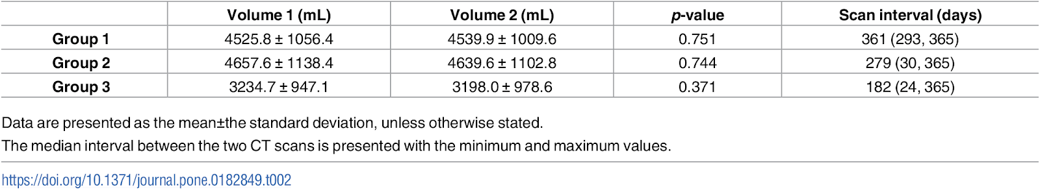
DRILL
Congratulations on replicating a research study!

Slide 37

PARAMETRIC AND NON-PARAMETRIC TESTS
Notes:
When we get a dataset, we want to see the kinds of variables we have. Think of each variable as like an ingredient. And based on those ingredients we can make different dishes. Like a “Chopped” competition.

Slide 38
DEMO
Demo: cortisol.xlsx
Is there a difference in morning versus evening doses?
Check the normality assumption!
Wilcoxon signed-rank test

Slide 39
WHAT JUST HAPPENED?
Parametric | Non-parametric
Assumptions are made about the population parameters | No assumptions made about the populations
More rigid, more powerful, less flexible | Less rigid, less powerful, more flexible
Test statistic is based on probability distribution | Test statistic is arbitrary

Slide 40
DRILL
Demo: rfft.xlsx
Is there a difference after the intervention?
Is there a significant difference in the number of perseverative errors drawn by the same participants from Measurement 2 to Measurement 3?
Higher secondary school
University
Lower secondary school
Measurement 1

Slide 41
QUESTIONS?
Notes:
Any questions on descriptive statistics?

Slide 42
2. WORKING WITH MULTIPLE GROUPS
Notes:
-- Update!
Let’s begin with Exploratory Data Analysis in Excel.
Pulse check – who has heard of this term before and how would you define it? Or outside of defining it, what are some examples of it?

Slide 43
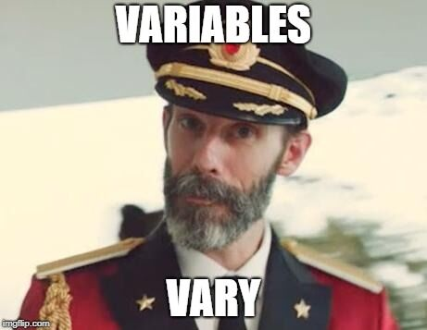
What is a variable?
Classical statistics: at least a 90%/10% split
Notes:
But before we even get into analyzing variables, let’s consider what they even are. It seems like a silly distinction but analyzing variables is what we do as analysts. For classical statistics, a variable needs to have at least a 90%/10% split to be considered a useful variable. This may seem like a trivial point, but consider something like anomaly detection where the event we are interested in may only be a one in a thousand event. This would not be a 90%/10% split, so a lot of classical statistics would have a hard time working on this problem. This is where ML/AI might come in.

Slide 44
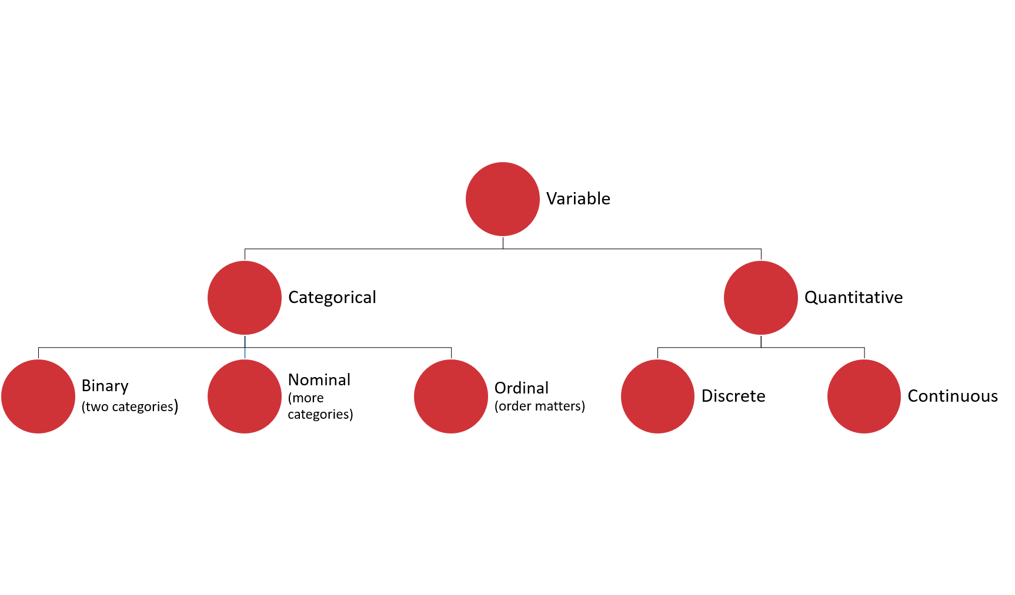
WHAT’S ON THE TABLE?
Notes:
Basic overview of the types of variables:
Broad split b/w categorical and quantitative
First, categorical. For these, there are a fixed number of values that variable can take:
- In the case of binary, it’s two (yes/no, black/white)
- Nominal can have more than two, think of all 50 states, or 7 days of the week
- For ordinal, order matters, consider Freshman/Sophomore/Junior/Senior. However this corresponds to years 1, 2, 3, 4, so these can be numbers too!
Then, quantitative. These are numeric
- With a difference that with discrete, there are only a certain number of values that can be taken, for example, you can’t have 2.5 children, but we often use that as a statistical convenience, so you will see there is some wiggle room here.
- Finally, continuous – this is the one for which there can be any possible value. Height/weight/blood pressure. A lot of things in the natural world. Also money is for all intents & purposes continuous.

Slide 45
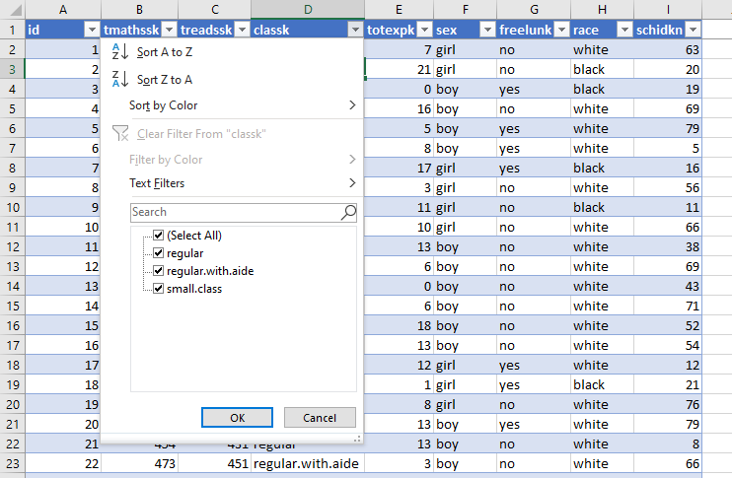
DRILL
File: star.xlsx
What type is each variable?
(Don’t be afraid to poke at the data!)
Variable | Description | Type?
tmathssk | Total math scaled score
treadssk | Total reading scaled score
classk | Type of class
totexpk | Years of total teaching experience
sex | Sex
freelunk | Qualified for free lunch?
race | Race
schidkn | School indicator
Notes:
Check out this dataset of school test scores. Consider what kind of variable you would classify as each. Make your best guess.

Slide 46
DRILL
File: star.xlsx
What type is each variable?
(Don’t be afraid to poke at the data!)
(Filtering for now…)
Variable | Description | Type?
tmathssk | Total math scaled score | Continuous
treadssk | Total reading scaled score | Continuous
classk | Type of class | Nominal
totexpk | Years of total teaching experience | Discrete
sex | Sex | Binary
freelunk | Qualified for free lunch? | Binary
race | Race | Nominal
schidkn | School indicator | Nominal
Notes:
Here is what I came up with. The first couple are more apparent, but what about things like Years of teaching experience?
That could be an ordinal variable or a discrete variable. It was also difficult to know whether race is binary or nominal, I did it for certain by placing a filter on it to see the distinct values.
Did anyone come up with other classifications and if so would you like to share them?

Slide 47

WHO KNOWS?
VARIABLE TYPES ARE CONTEXTUAL
IT’S NEBULOSE…
https://www.theanalysisfactor.com/level-of-measurement-not-obvious/
Notes:
Sometimes like in the case of the math and reading scores your variable may technically be more like a discrete variable but you can treat it more like a continuous variable. This is a fairly common occurrence. Age is a good example where it is technically continuous but for different reasons we may measure it as multinomial or discrete. I won’t spend too much time on this but if you want to learn more check out this article here which actually talks a lot about how to handle age as a variable.
Great, now we have some idea of the ingredients we are working with, although some of these ingredients are shape-shifters, but we can handle them. What do we do next?

Slide 48
Summarizing a variable: frequencies
Used for categorical variables
How many of each value do we have? (Counts)
Use PivotTables
Notes:
It’s great to look at each observation/row in isolation, but to get the “big picture” of a dataset we are going to have to summarize it.
The way we summarize a variable depends on the kind of variable it is (or at least we think it is!) If it is categorical, we can count it up.
For the demo: create a two-way cross-tab summarizing frequency counts of union/married. [Show/remind that instructions on the demo are available in the demo notes.]

Slide 49
DRILL
Demo: wages.xlsx
(Don’t forget about the demo notes)
Notes:
Let’s take an example here, and don’t forget about the demo notes!

Slide 50
Summarizing a variable: descriptive statistics
Used for continuous variables
Central tendency: what value is the variable centered around?
Mean: “average”
Median: “middle”
Mode: “most common”
Notes:
If our variable is continuous, there are quite a few ways to summarize it. We’ll start with central tendency or, what value is the variable centered around? We have a few options for measuring central tendency: mean, median and mode.

Slide 51
DRILL
You are consulting for a non-profit on fundraising strategies
Donation data is shown to the right
Which measure of central tendency (mean/median/mode) should be tracked?
Variable
10
10
20
30
100
Notes:
There is no right answer here! Just calculate the three statistics, use Excel or an online calculator if you aren’t sure what equations to use.
But again our goal is business impact here so we want to tie these measures to real business use cases.
Leave your thoughts in the chat as to what the important variable is.

Slide 52
DRILL
You are consulting for a non-profit on fundraising strategies
Donation data is shown to the right
Which measure of central tendency (mean/median/mode) should be tracked?
No one statistic rules them all
Variable
$10
$10
$20
$30
$100
Statistic | Value
Mean | $34
Median | $20
Mode | $10
Notes:
It depends what you want to track!
The average donation is perhaps inflated by the $100, and that is a big downside of using the average.
That is why the median can be more revealing as it is more reflective of a true “middle ground” which is also important to know.
Finally, you might want to know what the most common donation is, that would be the mode.
So, they are all important!
But, usually we are going to analyze the mean because that is more receptive to advanced analysis, you’ll see that if data is normally distributed, then the mean will be the most revealing measure for us.
You will also see from this example the importance of having enough data! Kinda hard to know what’s going to be important with only five observations!

Slide 53
Summarizing a variable: descriptive statistics
Variability: how spread is the variable from the center?
Range: What are the min/max?
Variance: Relative to the mean, how far away does the data fall?
Standard deviation: Square root of the variance
Standard error: accuracy with which a sample distribution represents a population (standard deviation / sample size)
Notes:
Now that we have established where the “center” of the variable is, we can explore how “spread” the variable’s values are from the center.
The most basic measure for this is the range or the min/max.
Then there is the variance and the standard deviation – these are more sophisticated measures of how far a value falls on average, relative to the mean.
Standard error – how much variation can we expect in our means if we drew many random samples.

Slide 54
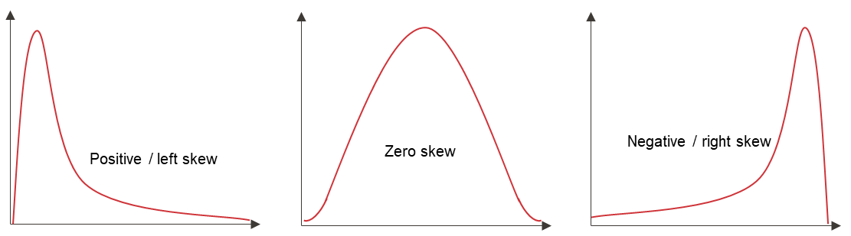
Summarizing a variable: descriptive statistics
Distribution: How is the data distributed?
Skewness: How lopsided is the data?
Notes:
Finally, we can look at skewness and kurtosis which describe the overall distribution of a variable. First, skewness – skewness describes how how “lopsided” the data’s distribution is overall.

Slide 55
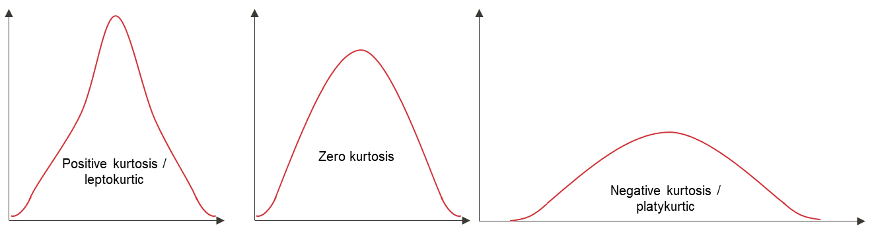
Summarizing a variable: descriptive statistics
Distribution: How is the data distributed?
Kurtosis: How jagged is the data?
Notes:
Kurtosis describes how “jagged” the data’s distribution is.
Great, now let’s actually measure all these in a dataset using Excel.

Slide 56
HAVE YOU INSTALLED THE DATA ANALYSIS TOOLPAK?
Notes:
Has everyone done this? If not, check the demo notes and/or follow along with the next two slides.
The steps are different for Mac versus Excel.

Slide 57
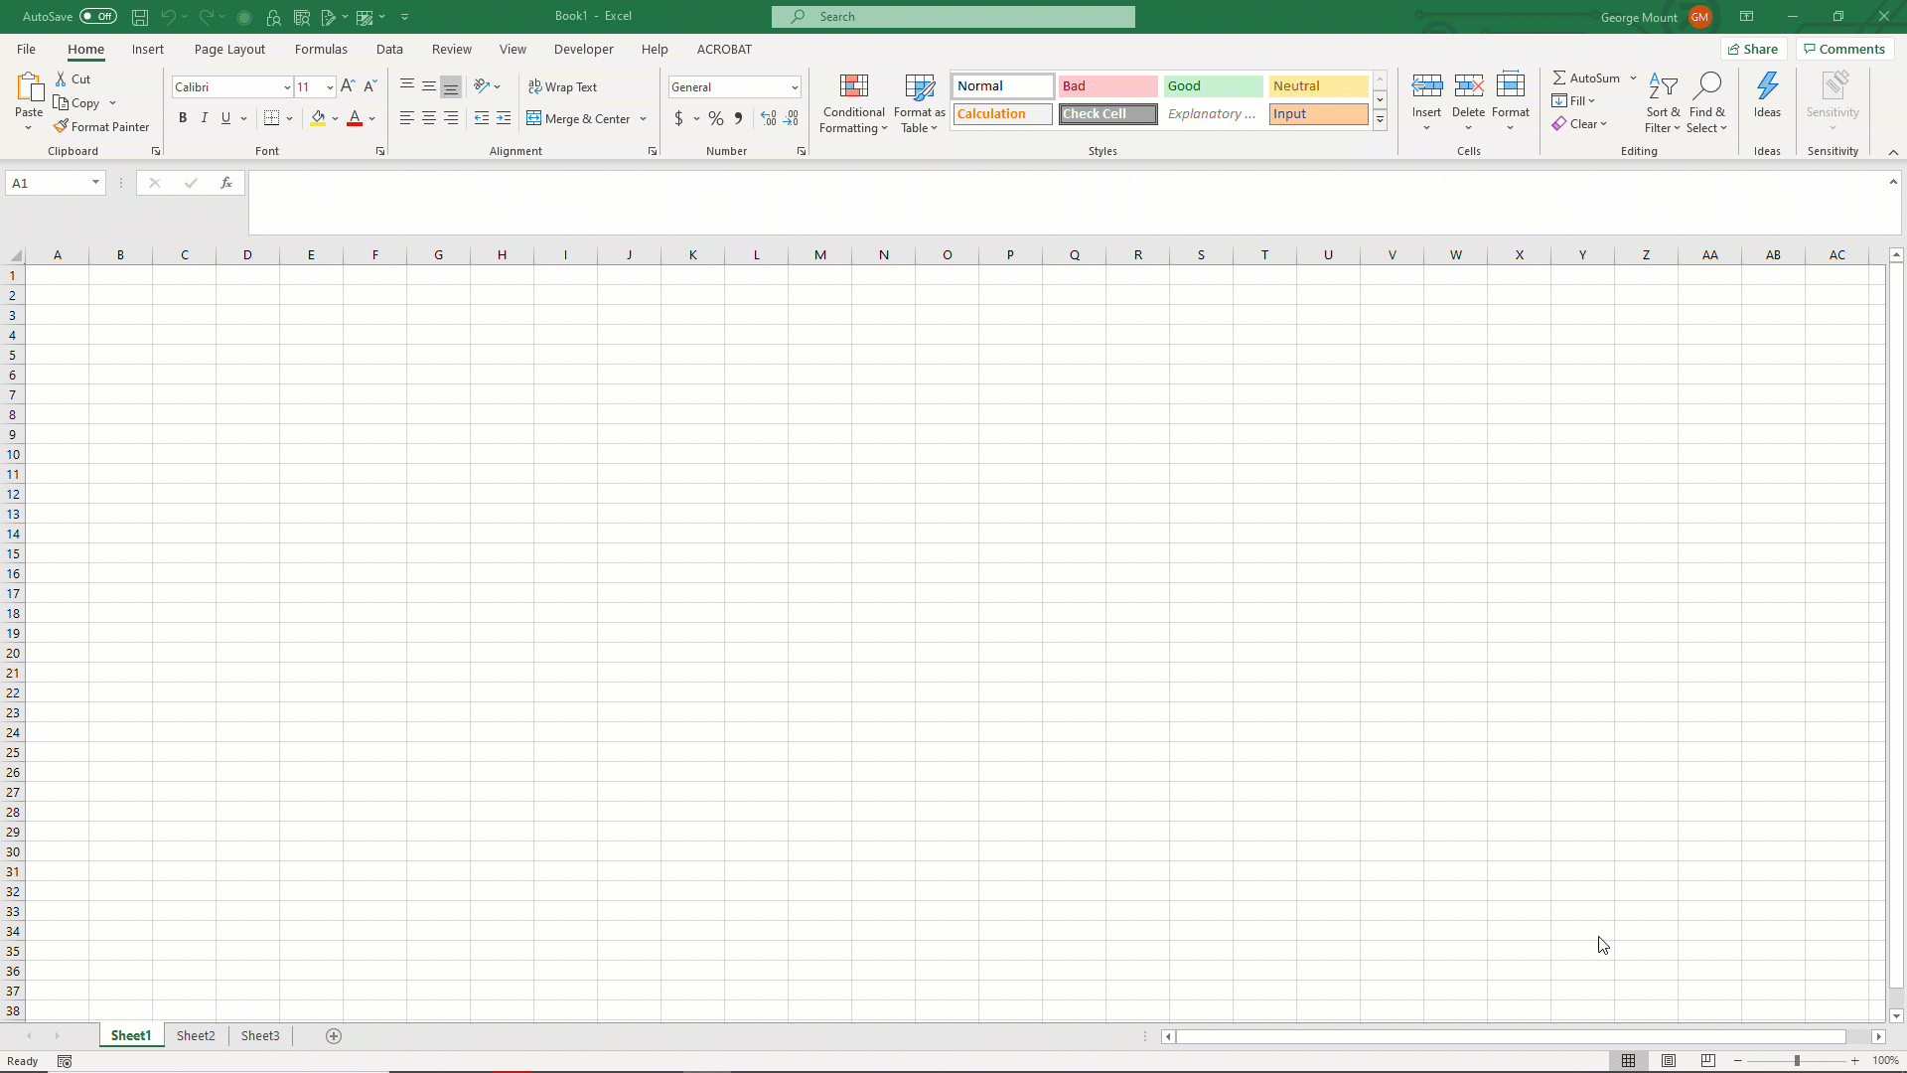
ON WINDOWS:

Slide 58
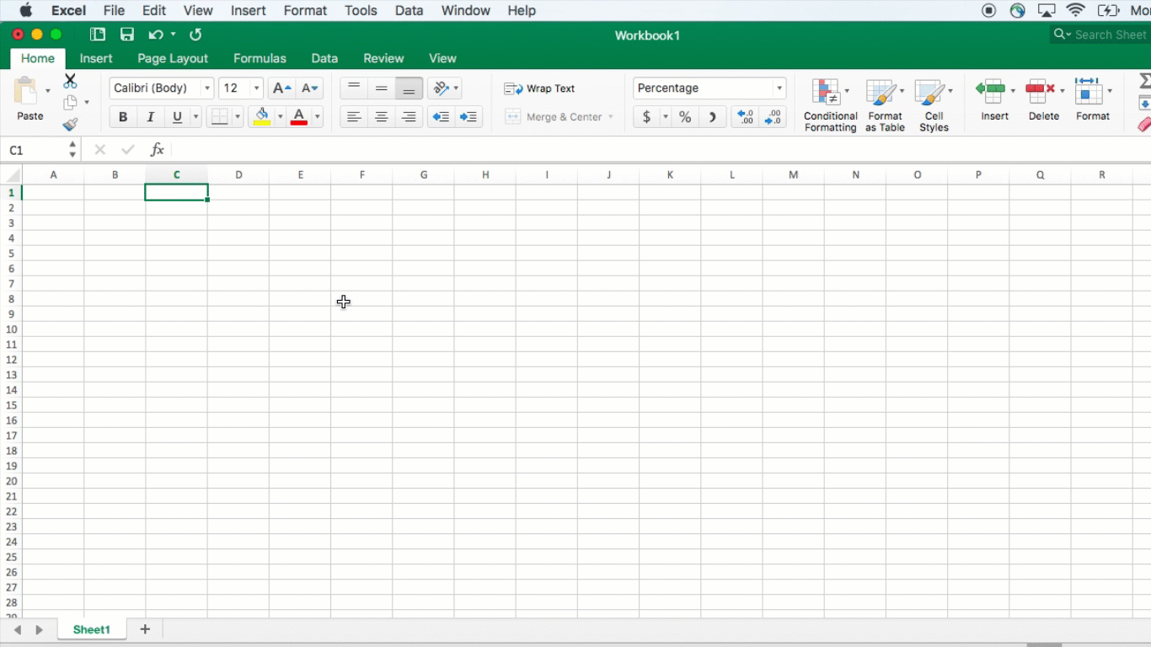
ON MAC:

Slide 59
DEMO
File: wages.xlsx
Summarize wage with the Analysis ToolPak
Notes:
Give me a thumbs up when everyone has this installed.
Open up the wages dataset, we will now summarize a continuous variable (wage) using the Analysis ToolPak.
Another reminder to use the demo notes.

Slide 60
Summarizing a variable: visualization
Histogram
What does the data’s distribution “looks like?”
How many data points lie with each bin?
Notes:
Getting the measures of skewness/kurtosis is great but there’s nothing quite like a picture! Let’s draw the actual visualization with a histogram.

Slide 61
DEMO
File: wages.xlsx
Visualize wage with a histogram
Notes:
Let’s do it!

Slide 62
DRILL
File: housing-descriptive.xlsx
Explore this dataset:
Choose a categorical variable and run its frequencies
Choose a continuous variable, run its descriptives and plot a histogram
Notes:
Now it’s your turn to do each of the three steps.
This is a real life dataset on housing prices. Do some EDA on this data.

Slide 63
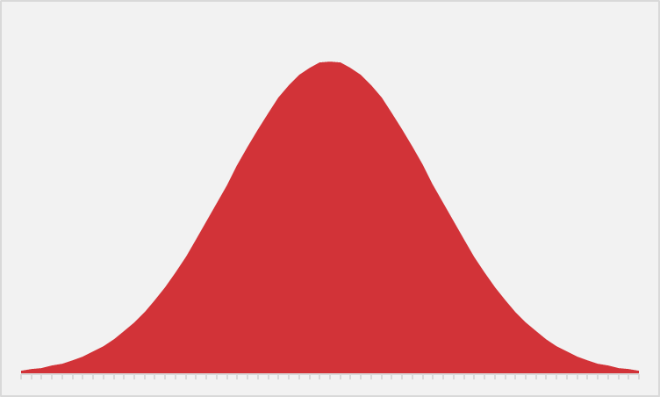
EVER WANTED TO JUST BE NORMAL?
STATISTICS IS YOUR CHANCE.
Notes:
The normal distribution of paramount in statistics. We are able to extrapolate pretty well about a variable’s value when it falls on a bell curve because we know exactly how “spread” the variable’s values are around its center.
Next slide for some specifics.

Slide 64
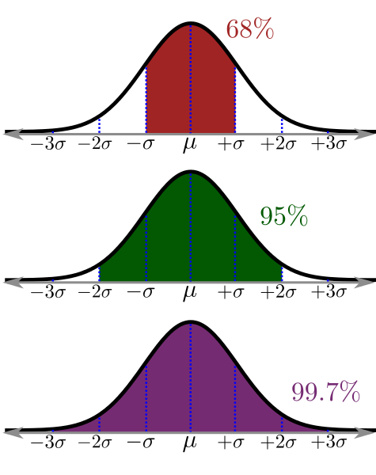
WHAT DOES IT MEAN TO BE NORMAL?
“Empirical rule”
https://www.katemarshallmaths.com/chapter-3-bell-shaped-distribution.html
Notes:
This is called the empirical rule and it tells us how many observations we expect to fall within how many standard deviations of the mean. We can expect that 68% of our observations fall within 1 standard deviation, 95% within 2, and 99.7% within 3. This allows us to state how likely or unlikely it is to get any certain value.

Slide 65

SPOTTING NORMAL DISTRIBUTIONS
There are no “perfectly” normally distributed variables, but some are more normal than others:
Descriptives: skewness ± 8, kurtosis ± 20
Visualizations: does it “look” normal?
Inferentially: is it statistically distributed differently than normal?
https://www.katemarshallmaths.com/chapter-3-bell-shaped-distribution.html
Notes:
https://pixabay.com/photos/bigfoot-evolution-anthropoid-ape-542546/
The interesting thing about the normal distribution is that while we see approximations to it everywhere, it’s nearly impossible to find it perfectly in real life. Some ways we can check whether a variable is normally distributed enough are with descriptive statistics. We can check whether its skewness and kurtosis fall within a certain range, this is a pretty generous range here, but a perfectly normal distribution will have a skewness and kurtosis of 0, so the closer to 0 the more normal it is.
We can also visualize it and we’ve been using histograms to do that. With this we can see whether the variable “looks” normal, or how “bell-shaped” it appears.
Finally there are some other ways to test normality but we won’t get into those, we can perform a statistical test to check whether our variable is likely to be different than normal. The cool thing is that after this course you will understand how tests like these work at a basic level.

Slide 66

STATROULETTE
A roulette wheel returns values between 0 and 36.
Let’s simulate a game of roulette in Excel
Notes:
Instructions follow on the next slide.

Slide 67
DEMO
Simulate 500 rounds of a roulette spin.
Plot the resulting frequency distribution.
Notes:
More instructions on next slide.
Ask if anyone knows what formula to use for this.

Slide 68
DEMO
Simulate 500 rounds of a roulette spin using RANDBETWEEN(0,36)
Plot the resulting frequency distribution using a histogram
Hit F9 while in your workbook. What happens?
Notes:
Resulting screenshot to be shown on next slide.
If you need help with the plotting, go to the older demo notes, that’s what we did before.
Don’t look ahead in the slides!

Slide 69
DEMO
Now, simulate a roulette spin 100 times.
Take the average spin.
Do this 500 times.
Plot the distribution of sample means
Solution: stat-roulette.xlsx
Notes:
Now we will take the average roulette spin after spinning 100 times. Do this 500 times and plot the histogram of the average spins. What happens this time?
Don’t look ahead in the slides!

Slide 70

MAGIC… OR STATISTICS?
Central limit theorem: the sampling distribution of the mean of any independent, random variable will be normal or nearly normal, if the sample size is large enough.
Notes:
Magic, or statistics? This is courtesy of the central limit theorem. Sample means tend to normality, which means since we know the probability distribution, we can make reliable estimates about a population, given a sample, as we extrapolate to that population.

Slide 71
How “large enough” is large enough?
N = 30? 60? 100?
It depends on how “normal” your sample is
Notes:
The big caveat is that a sample has to be “large enough.” What does that mean? Well, the base case is 30. 60 is better and 100 is even better. If your data’s sample is already looking normal, it’s going to take a smaller sample size to hit that “large enough” qualification. So generally a normally distributed variable is considered a requirement to do these statistics in practice, whereas in theory this is not such a dead-locked requirement.

Slide 72

MEET ME IN THE MIDDLE
A roulette wheel returns values between 0 and 36.
What is the average roulette spin given more and more spins?
Notes:
https://unsplash.com/photos/3qMOyoqI-JM
Instructions follow on the next slide.

Slide 73
DEMO
large-numbers.xlsx

Slide 74
MAGIC… OR STATISTICS?
Law of large numbers: the average of results obtained from trials become closer to the expected value as more trials are performed
Notes:
Magic, or statistics?

Slide 75
QUESTIONS?
Notes:
Ok, let’s end our EDA module on the Central Limit Theorem as you’ll see it’s the “missing link” between descriptive and inferential statistics.
We are done with the first module! Any questions?

Slide 76
2. FOUNDATIONS OF INFERENTIAL STATISTICS
Notes:
In this module we will begin to take what we’ve learned about our sample data, and how sample means behave, and put those together to start making inferences about a population based on a sample.

Slide 77

HOUSES WITH AIR CONDITIONING ARE BETTER THAN THOSE WITHOUT
Notes:
Again, I really want to focus this on real-life business applications so this is not some academic undertaking, so let’s say that we are real estate analysts and we want to consider what kinds of features on a house help.
We might start with a claim like this. I don’t think anyone would disagree with this statement, but how would we actually quantify that? What can we measure to compare a difference in quality between houses with and w/o air conditioning?

Slide 78
HOUSES WITH AIR CONDITIONING ARE BETTER HAVE HIGHER SALES VALUES THAN THOSE WITHOUT
Notes:
Price! Price is a readily quantifiable value that could stand in for quality that I think a lot of business managers would be pleased with learning more about. Do homes with AC sell for a higher value? Now we are talking business.

Slide 79
HOUSES WITH AIR CONDITIONING ARE BETTER HAVE HIGHER SALES VALUES THAN THOSE WITHOUT, ON AVERAGE
Notes:
But let’s qualify further, how are we going to compare housing prices? Well, we could ask on average whether homes with AC sell for higher. Now we are making a readily measurable claim.

Slide 80
HOUSES WITH AIR CONDITIONING HAVE HIGHER SALES VALUES THAN THOSE WITHOUT, ON AVERAGE, GIVEN THE SAMPLES WE HAVE
Notes:
Of course, we can’t measure the sale price of EVERY house, we are going to take a sample. So we need to be very specific about what we are measuring.
However you are going to find that through some of the principles you learned earlier that we can actually make some claims about ALL houses given a SAMPLE of houses that we took.

Slide 81

THE AVERAGE VALUE OF ONE CATEGORY IS HIGHER THAN ANOTHER
(Independent samples t-test)
Notes:
Let’s think about what we just did here, essentially we are looking for a difference in the average of some continuous variable between two categories. Going back to our analogy, with these two ingredients we can make the “recipe” of an independent samples t-test.
Before we run the test, we want to fully explore the variables we are going to test. This is like measuring out our ingredients to make sure the recipe is right.

Slide 82

DEMO
File: housing-foundations.xlsx
Is there a difference in sales price for homes with air conditioning (airco)?
Find the descriptive statistics and plot the histograms for each category
Notes:
So, using the tools we’ve learned so far (frequencies, descriptive statistics, histograms), let’s see what we can learn about a difference in means between homes w/ and w/o AC.

Slide 83

DRILL
File: housing-foundations.xlsx
Is there a difference in sales price for homes with a full, finished basement (fullbase)?
Save your work – you’ll “build on” it later!
Notes:
Photo source: https://unsplash.com/photos/T-br3SYp9kw
Now it’s your turn to follow the steps taken so far.
“Build on” is a pun :P

Slide 84

We have the data… just not all of the data
There is a difference across 546 homes…
… but what about all homes?
Is our sample reflective of their populations?
Notes:
https://unsplash.com/photos/iuqxv7kFj64
So, we were able to compare the means between the two samples, but we want to check that what we’ve found in the data is not a fluke, there are a lot more than 546 houses, we want to know whether this story can be told for ALL homes, not just the homes we have measured. So how are we going to do that?

Slide 85

… but that doesn’t stop your phlebotomist!
Or your pollster
Or your QA manager
Or your real estate analyst 😉
Notes:
https://pixabay.com/photos/laboratory-analysis-diagnostics-2815639/
To think about how this would work, consider that when you get a blood lab done, you aren’t offering ALL of your blood! A phlebotomist can take a pretty tiny amount of blood and then the lab is able to generalize those results to your entire body.
Pollsters do the same thing, with a relatively small sampling are able to predict for populations (to middling effect sometimes 🤷‍♂️)
We can use these same principles to analyze real estate!

Slide 86

GETTING RIGOROUS WITH A HYPOTHESIS
Testable
Falsifiable
Burden of proof on the claimant
Notes:
Now we want to move from asking, “Do houses with air conditioning have higher values than those without?” to an actual hypothesis. A good hypothesis will meet a few criteria:
First, it must be testable. We’ve already done a good job with that by making sure we can gather and measure the data used for this problem.
Related to that it should also be falsifiable, we should be able to get a clear “yes or no” result from the hypothesis.
Finally, the burden of proof of a hypothesis is on the claimant – think about a courtroom, where a suspect is innocent until proven guilty. We need to “start from the status quo.” So in the analysis we are conducting, the burden of proof is on us to show that there is a difference in means, the status quo would be that there is no difference.

Slide 87
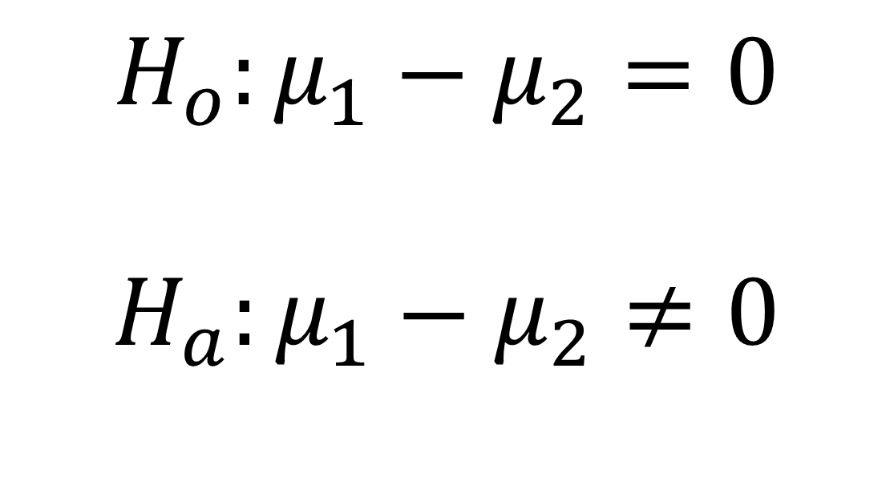
GETTING RIGOROUS WITH A HYPOTHESIS
Null hypothesis: no difference in population means
$$H_{o}:μ_{1}−μ_{2}=0$$
$$H_{a}:μ_{1}−μ_{2}≠0$$
Alternative hypothesis: some difference in population means
Notes:
Hypothesis testing is rigorous, so we’ll even translate this into math-speak! Here the mu-1 and mu-2 indicate population means 1 and 2. Yes, we are talking about the ENTIRE “population” of homes, not just the “sample” of homes we have collected. The “status quo” is that there is no difference, and it’s up to us to provide evidence to the contrary.

Slide 88
… but we don’t know the population means…
Central limit theorem to the rescue!
Infer the population mean (which is normally distributed) given a sample mean…
... Some uncertainty required.
Usually 5%
Notes:
How can we talk about the population means, when we don’t know the population means? We can do so because we can infer a population’s mean, given a sample mean, because of the fixed probability distribution of the sample means.
Still, this is speculative, we don’t know the population’s mean! So some “guessing” or uncertainty is required. We need to pick some level of uncertainty that we are comfortable with. Generally this is 5%. We’ll use this level too.

Slide 89
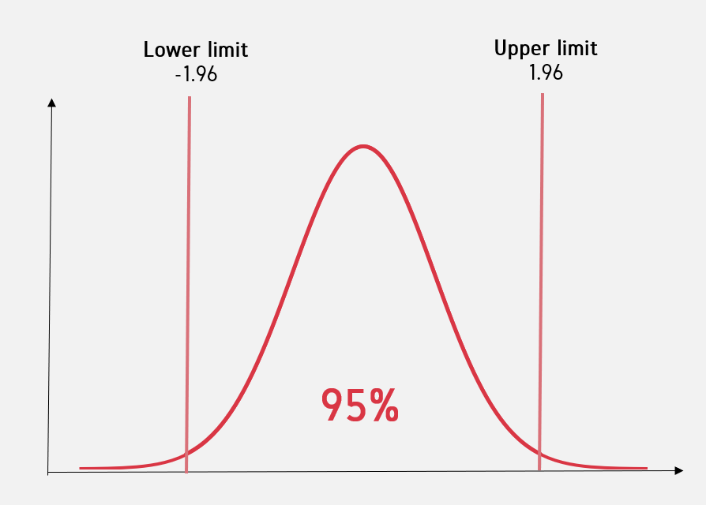
Critical value
Notes:
Okay, so let’s look at a picture of what this all actually means. Imagine we have the distribution of sample means. Based on our sample we can infer some likely boundaries within which the population mean would be. 95% is usually the “likely bounds” we choose. Outside this range, we would say that it’s unlikely to find this sample mean among the population. This “make-or-break” boundary is known as the “critical value” and for the 95% confidence interval it will be 1.96. We will calculate a test statistic and if it falls outside of the +/- 1.96 range than it’s considered a statistically significant value.
So, how do we come up with all these calculations? The test statistics and all that? Well, that will require some math, so buckle up.

Slide 90
EXPLICIT WARNING:
MATH AHEAD
Notes:
Brace yourselves!

Slide 91
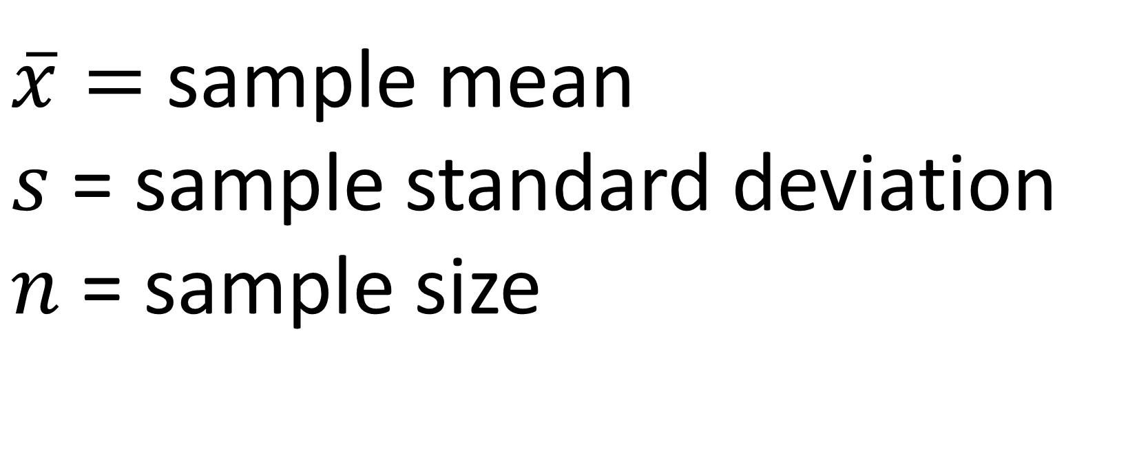
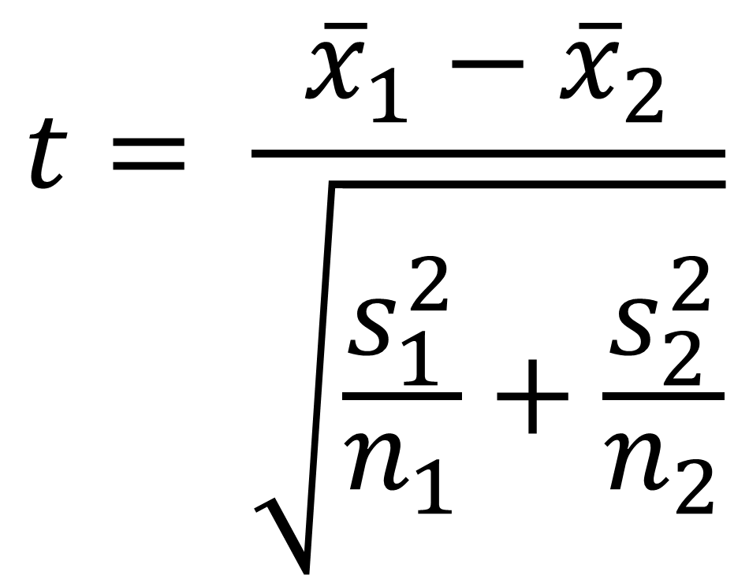
Calculating the test statistic
$$t= \frac{{\overline{x}}_{1}−{\overline{x}}_{2}}{\sqrt{\frac{s_{1}^{2}}{n_{1}}+\frac{s_{2}^{2}}{n_{2}}}}$$
$\overline{x}=$ sample mean
$s$ = sample standard deviation
$n$ = sample size
Notes:
Here is how we test the test statistic for an independent samples t-test. Remember, we want to know if a difference in means is likely to be found in a population, given a sample.
If this resulting value exceeds +/- 1.96, then it’s significant.

Slide 92
Does the test score exceed the critical value?
Yes: Reject the null. There is likely to be a significant difference in means.
No: Fail to reject the null. There is unlikely to be a significant difference in means.
Two-tail t-test
Notes:
If a test statistic exceeds the critical value, then we would reject the null.
Otherwise, we fail to reject the null.
Notice the delicate language here?

Slide 93

In statistics, nothing is proven, everything is falsifiable.
Notes:
Again, we don’t actually know the population values! So we can’t say for certain what is what! We can only infer population means, given our sample means, and the magic of the central limit theorem.

Slide 94
QUESTIONS?
Notes:
Any questions about the “hypothetical” stuff here so far? (lol)
Don’t get too hung up on this part, it will make more sense in action when we actually begin to crunch the numbers in Excel.

Slide 95
3. T-TESTS FOR BUSINESS IMPACT
Notes:
We’ll do that now in this section, again with the emphasis on driving some business impact on what we are doing.

Slide 96
WARM-UP
We want to test for a significant difference in sale price between houses with and without air conditioning.
What are our hypotheses?
Notes:
It’s good practice to write out the hypotheses we are going to be testing.
If we are using the Greek notation, they will be the same notation each t-test ☺

Slide 97
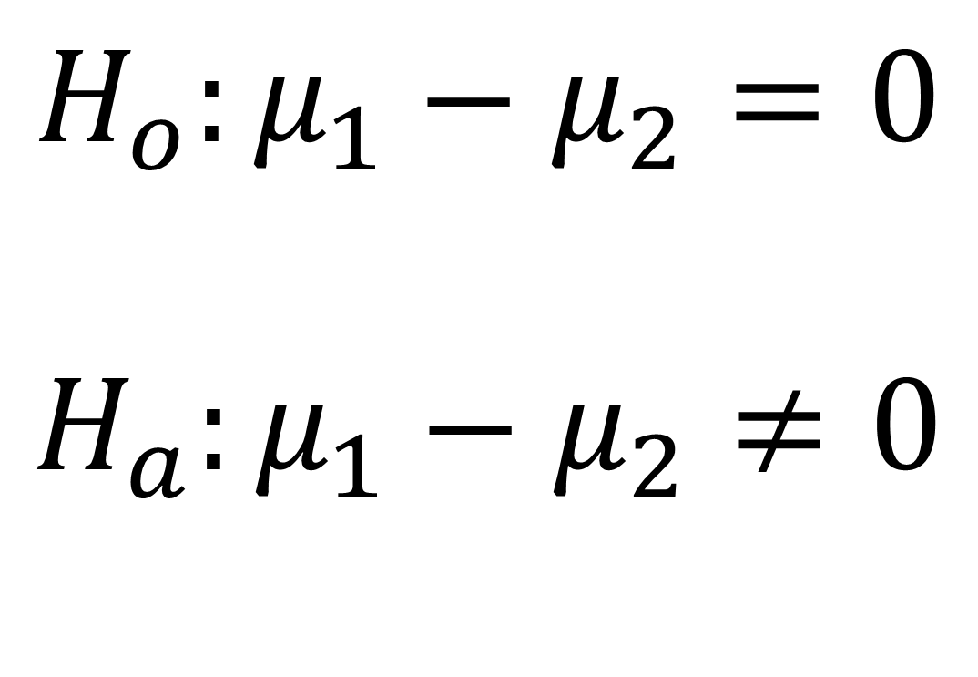
WARM-UP
We want to test for a significant difference in sale price between houses with and without air conditioning.
What are our hypotheses?
$$H_{o}:μ_{1}−μ_{2}=0$$
$$H_{a}:μ_{1}−μ_{2}≠0$$
Null hypothesis: there is no difference in the average sale price of homes with and without air conditioning.
Alternative hypothesis: there is a difference in the average sale price of homes with and without air conditioning.
Notes:
It’s good practice to write out the hypotheses we are going to be testing.
If we are using the Greek notation, they will be the same notation each t-test ☺

Slide 98
DEMO
File: housing-inferential.xlsx
Is there a significant difference in sales price for homes with air conditioning?
Notes:
So, we analyzed the sample data, now let’s check for a “generalizable” difference based on these samples. This is “statistical significance.” Follow along and check the Demo Notes later.

Slide 99
DRILL
File: housing-inferential.xlsx
Is there a significant difference in sales price for homes with a full, finished basement?
Save your results for later!
Notes:
Your turn to walk through a t-test.

Slide 100
DEMO -- SUMMARY
Two-tailed independent samples t-test
95% confidence = critical value of 1.96 = p-value of .05
p < .025
p < .025
Notes:
So, we analyzed the sample data, now let’s check for a “generalizable” difference based on these samples. This is “statistical significance.” Follow along and check the Demo Notes later.

Slide 101
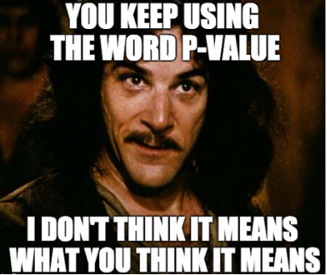
A p-value is NOT a probability of making a mistake.
A p-value is the probability of obtaining an effect at least as extreme as the one in your sample data, assuming the null hypothesis is true.
Notes:
So, we calculated the p-value and found significance, but what did we actually find here? It is NOT the probability of making a mistake, it is a measure of how likely it would be to find the observed difference in means, if there were actually no difference in population means.
Let’s walk through some p-value interpretations on the next slide.

Slide 102
SOLD: $200,000
SOLD: $200,000
If this were true in the population, you’d have found this in < .005% of samples due to random error.
Notes:
Your turn to walk through a t-test.

Slide 103
INTERPRETING P-VALUES
p-value | Interpretation
.02 | Assuming the null is true, you would obtain the observed difference or more in 2% of samples due to random error.
.085
.5
.005
Notes:
It’s not the probability of a mistake but rather the likelihood of obtaining the observed difference or effect in a given sample, assuming no true difference in population means.
Take a moment to fill out the rest of these correctly.

Slide 104
INTERPRETING P-VALUES
p-value | Interpretation
.02 | Assuming the null is true, you would obtain the observed difference or more in 2% of samples due to random error.
.085 | Assuming the null is true, you would obtain the observed difference or more in 8.5% of samples due to random error.
.5 | Assuming the null is true, you would obtain the observed difference or more in 50% of samples due to random error.
.005 | Assuming the null is true, you would obtain the observed difference or more in .05% of samples due to random error.
Notes:
It’s not the probability of a mistake but rather the likelihood of obtaining the observed difference or effect in a given sample, assuming no true difference in population means.

Slide 105
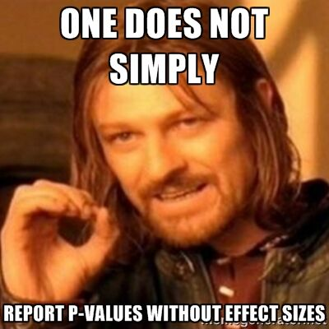
A p-value is NOT a substantive measure.
A p-value does not tell you how much of a difference there is, only that there is likely to be a difference.
The confidence interval will give us a substantive measure.
Notes:
A p-value also doesn’t tell us how BIG the difference/effect is. It would stand to reason that the lower the p-value, the bigger the actual difference in means, but this isn’t necessarily true. If we want to know the actual bounds within which we are assuming the population means to fall, we would want to calculate the confidence interval.
It’s a good idea to calculate the confidence interval! Unfortunately many statistical programs such as Excel and Python do not give you the confidence interval by default. (R does!) so we will have to take it into our own hands. Don’t become overly dependent on the p-value!

Slide 106
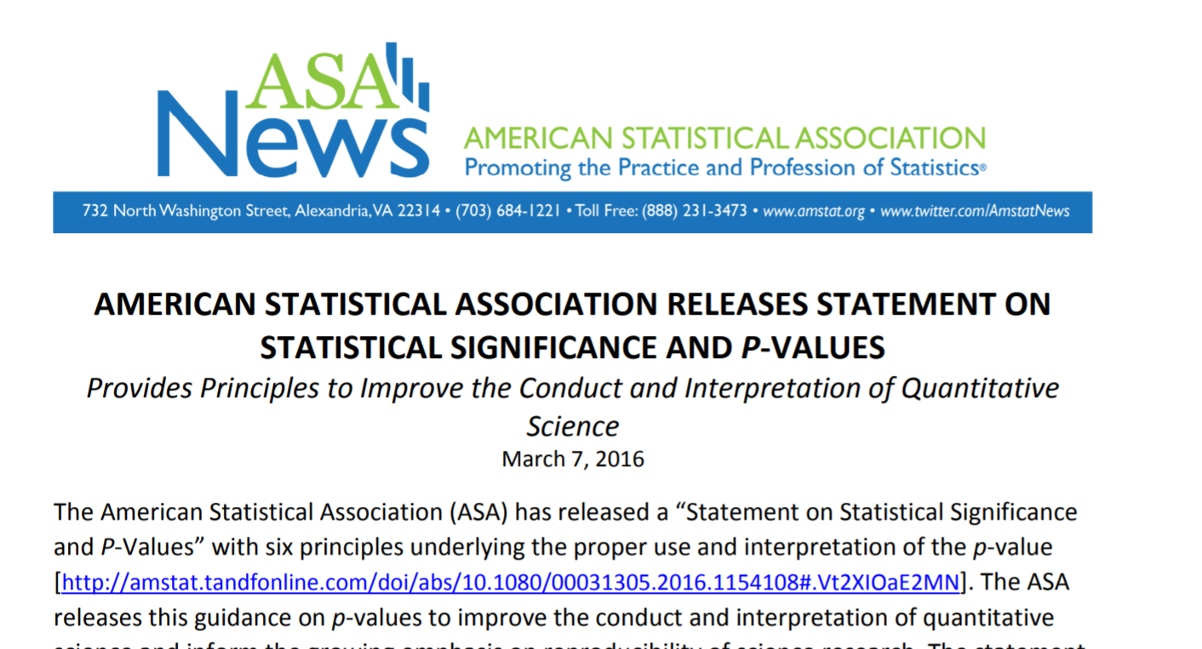
ONE STAT TO RULE THEM ALL
https://www.amstat.org/asa/files/pdfs/P-ValueStatement.pdf
Notes:
Again, the p-value is not the be-all and end-all of statistical analysis! Too often it has become that, a threshold to qualify for publication, funding, etc, but the ASA has taken some steps away from this, because we want a more holistic data analysis.
A little more math here, everyone ready? So we can actually calculate the confidence interval, since it’s important too!

Slide 107
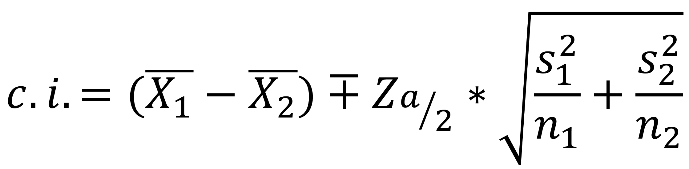
Calculating the confidence interval
$$c.i.=(\overline{X_{1}}−\overline{X_{2}})∓Z_{a/2}∗\sqrt{\frac{s_{1}^{2}}{n_{1}}+\frac{s_{2}^{2}}{n_{2}}}$$
Point estimate (difference in sample means)
Margin of error
(Critical value * standard error of difference)
Notes:
The confidence interval is in three “parts” here. First the point estimate is our real sample mean, then we multiply our critical value (which is again 1.96 for us) times what’s known as the standard error which is our population’ s standard deviation divided by the square root of the sample – again, we don’t actually know this information, so we’ll substitute with the sample information.
But this gives us a range of values around which we’d expect the population mean to fall.
The “variable” part of this is the “margin of error.” You may hear that a margin of error is 2-3% of the estimate, with a poll for example, this is a measure of the “wiggle room” which the confidence interval represents.

Slide 108
DEMO
File: housing-ci.xlsx
Calculate the confidence interval for difference in prices for homes with air conditioning
Notes:
We will continue in our analysis of air conditioning & prices, again the confidence interval is not included with the ToolPak so we will have to crunch these numbers ourselves.

Slide 109
DRILL
File: housing-ci.xlsx
Calculate the confidence interval for difference in prices for homes with a full, finished basement
Notes:
Now it’s your turn to build on your analysis from the last drill.

Slide 110
DEMO
File: margin-of-error.xlsx
Why do pollsters report a “margin of error?”
Why is it usually 2-3%?
Notes:
We will continue in our analysis of air conditioning & prices, again the confidence interval is not included with the ToolPak so we will have to crunch these numbers ourselves.

Slide 111

PRESENTING T-TEST RESULTS FOR BUSINESS IMPACT
Methods are not stories
Translate to the universal denominator … $
“The results were significant at p < .005” or
“With 95% confidence, a house with AC sells for between $6K and $15K more.”
When in doubt, visualize it
Notes:
That’s great but what about actually taking this analysis to your boss? I don’t think a lot of bosses would want to hear about what your test statistic was and what critical value you used. You instead want to tell some cohesive story about the data analysis.
Now this is not a class about storytelling with data, and there are some OLT classes that would help with this, but I know one thing that always tells a good story to managers is MONEY. Money talks, right? So the most you can bring your analysis into actual money, the better.
Finally, when in doubt with how to drive home a data story, it’s never a bad idea to visualize your results, so let’s do so with a t-test.

Slide 112
DEMO
File: housing-viz.xlsx
Visualize the difference in average sales price for homes with air conditioning
Notes:
Let’s continue with our AC analysis by drawing a picture of the results.

Slide 113
DRILL
File: housing-viz.xlsx (continued)
Statistically test and visualize the difference in average sales price for homes with gas for hot water heating, gashw (Note: new variable!)
Notes:
Now it’s your turn – notice this is a new variable!
This is your chance to run the whole analysis – from descriptives by category to visualization.
Parts of this analysis are going to look funky, which was intended ☺

Slide 114
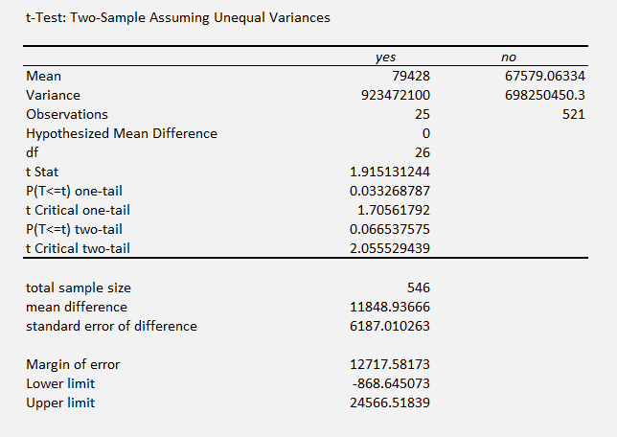
It’s your world, the data is just living in it
A p-value has wiggle room
A confidence interval communicates what’s at stake
A larger sample size can lead to more robust results
CASE
WHEN condition THEN result-expression
WHEN condition THEN result-expression ...
ELSE result-expression
END AS alias
Notes:
Here is an interesting analysis. There doesn’t appear to be a difference in prices of homes with gas heating, but our sample size of Yes’s is only 26! And guess what, we are looking at a swing of between -$900 and $24,500. So I wouldn’t reject this out of hand just because it’s a .06 p-value. I would want to get a little more Yes data to make this relationship a little more clear.
So, this analysis is just a guide, it’s not the be-all, end-all!

Slide 115
QUESTIONS?
Notes:
We are done with t-tests, any questions!
On to the conclusion.

Slide 116
4. CONCLUSION

Slide 117
Future learning
Check the 4-conclusion folder for additional t-test practice
Experimental design & A/B testing
Testing multiple categories/non-normal categories/the same observations at multiple time points
Linear regression
Notes:
To continue learning, a few options:
First, I have collected some datasets that have the right “ingredients” in them for a satisfying t-test, have at them!
Second, what we really didn’t get into was how to sample this data to come up with reliable results in the first place. This gets into concepts like sampling bias and more broadly experimental design. This seems like it would be rather academic but actually is a pretty valuable business skill to have especially in the context of A/B tests.
We’ve also only scratched the surface of inferential statistics, that is, comparing the means of two somewhat normally-distributed categories, there are quite a few other tests to be aware of, again “different recipes for different ingredients.”
Finally the linear regression is the Mac-daddy of classical statistics and in many ways is a link between classical statistics and more modern machine learning techniques.
A couple of books that are on OLT which will help you on this learning path:

Slide 118
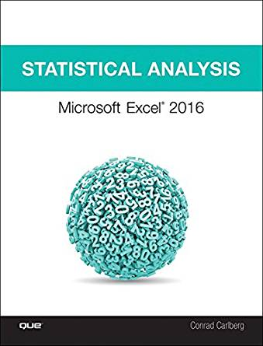
Statistical Analysis: Microsoft Excel 2016, by Conrad Carlberg
On O’Reilly Learning at https://learning.oreilly.com/library/view/statistical-analysis-microsoft/9780134840437/
Human Centered Design • MDLS 2020
Notes:
First, this is a pretty comprehensive look at doing statistics in Excel, this will indeed take you all the way through into linear regression, using Excel.

Slide 119

Data Smart: Using Data Science to Transform Information into Insight,
by John Foreman
On O’Reilly Learning at https://learning.oreilly.com/library/view/data-smart-using/9781118661468/
Human Centered Design • MDLS 2020
Notes:
This is a more “modern” approach to statistical analysis in Excel and will show you techniques like clustering, naïve Bayes, and things that you might not have thought possible in Excel, but again by learning them in Excel you get a really hands-on look at how these algorithms work that you may not necessarily get in R or Python (I quoted from this book way at the beginning in explaining why we would want to learn this stuff in Excel!)
The final chapter of this book does show you how to move into R from spreadsheets which is not a bad idea when you want to “productionize” what you have learned, but spreadsheets are really an awesome learning tool.

Slide 120
LET'S TALK
LINKEDIN
linkedin.com/in/gjmount
EMAIL ADDRESS
george@stringfestanalytics.com
WEBSITE
stringfestanalytics.com
GITHUB
github.com/summerofgeorge
Notes:
Thanks for coming! Feel free to contact me anytime, find me on LinkedIn, I also write frequently on this stuff so check out my website too.

Slide 121
QUESTIONS?
Notes:
Any final questions?

